Slide 1
Edge API Lifecycle and Tools
API Design & Documentation using OpenAPI

Slide 2
Open API Initiative
What?
Open governance structure under the Linux Foundation focused on standardizing how REST APIs are described
Who?
3scale, Apiary, Apigee, Atlassian, CapitalOne, Cloud Elements, Google, Hart, IBM, Isa, Mashape, Microsoft, Paypal, Restlet, Artik Cloud, SmartBear, Tyk.io
How?
This vendor agnostic API description format is based in the OpenAPI specification donated by SmartBear.

Slide 3



OpenAPI Specification (OAS)
Open source framework backed by a large ecosystem of tools helping design, build, document, and consume RESTful APIs.
Design APIs in an editor visually rendering the definition with real time feedback and error handling.
Quickly build APIs turning a OpenAPI definition into code (server stubs, client libraries). Over 40 languages supported.
Generate interactive documentation allowing end consumers to easily use the API.
Design
Build
Document

Slide 4

OpenAPI Specification (OAS)
General information about the API
Available paths (/resources)
Available operations on each path (get /resources)
Input/Output for each operation

Slide 5
OpenAPI Specification (OAS)
---
swagger: '2.0'
info:
version: 1.0.0
title: Echo
description: |
#Echos back every URL, method, parameter and header
schemes:
- http
host: mazimi-prod.apigee.net
basePath: /echo
paths:
/:
get:
responses:
200:
description: Echo GET
post:
responses:
200:
description: Echo POST
parameters:
- name: name
in: formData
description: name
type: string
- name: year
in: formData
description: year
type: string

Slide 6
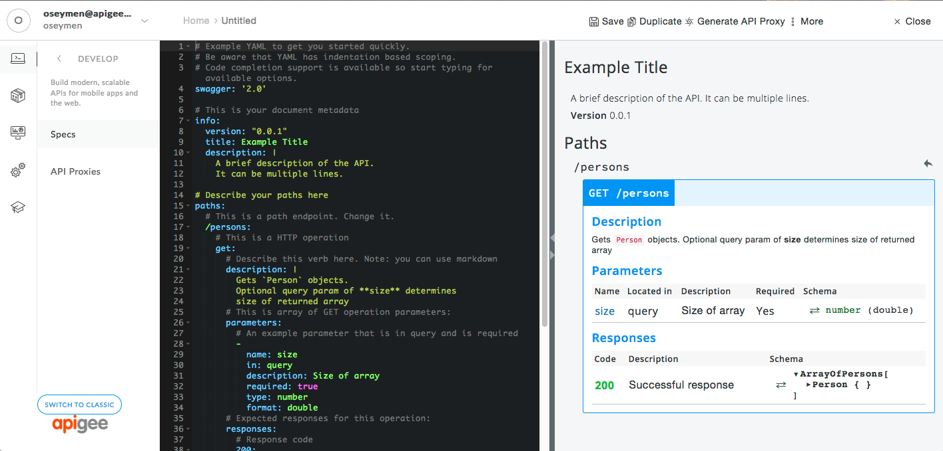
Edge Specs
Embedded OAS editor
Specs Management
Generate new API Proxies

Slide 7
Smartdocs
SmartDocs lets you document APIs on the Developer Portal so the API documentation is fully interactive, meaning that users can:
Read about your APIs
Send a live request to your API
View a live response returned from the API
The general steps that you follow to use SmartDocs are:
Configure the Drupal SmartDocs module on the portal.
Create a SmartDocs model.
Add APIs to the model from a WADL file, OpenAPI specification, or manually.
Render the model as a collection of Drupal nodes.
Publish the Drupal nodes. Once published, your developer portal users can view and interact with your API.
Enable TLS. SmartDocs can send authentication credentials to the backend as part of making a request to the APIs. This way we ensure that those credentials are secure.

Slide 8
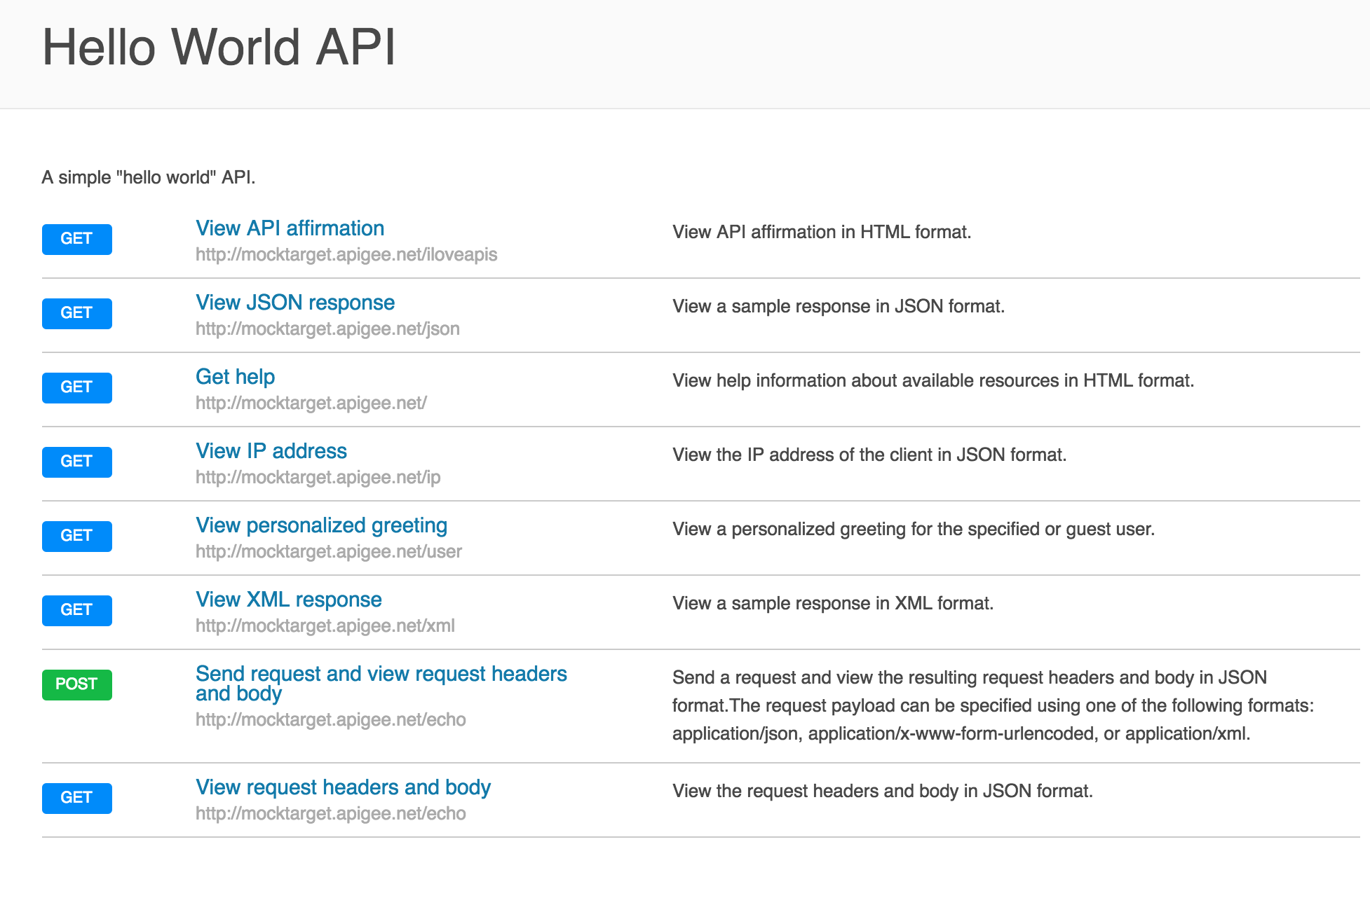
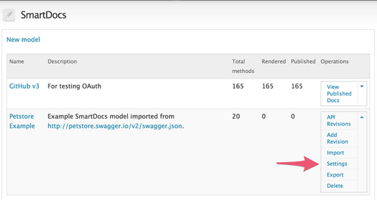
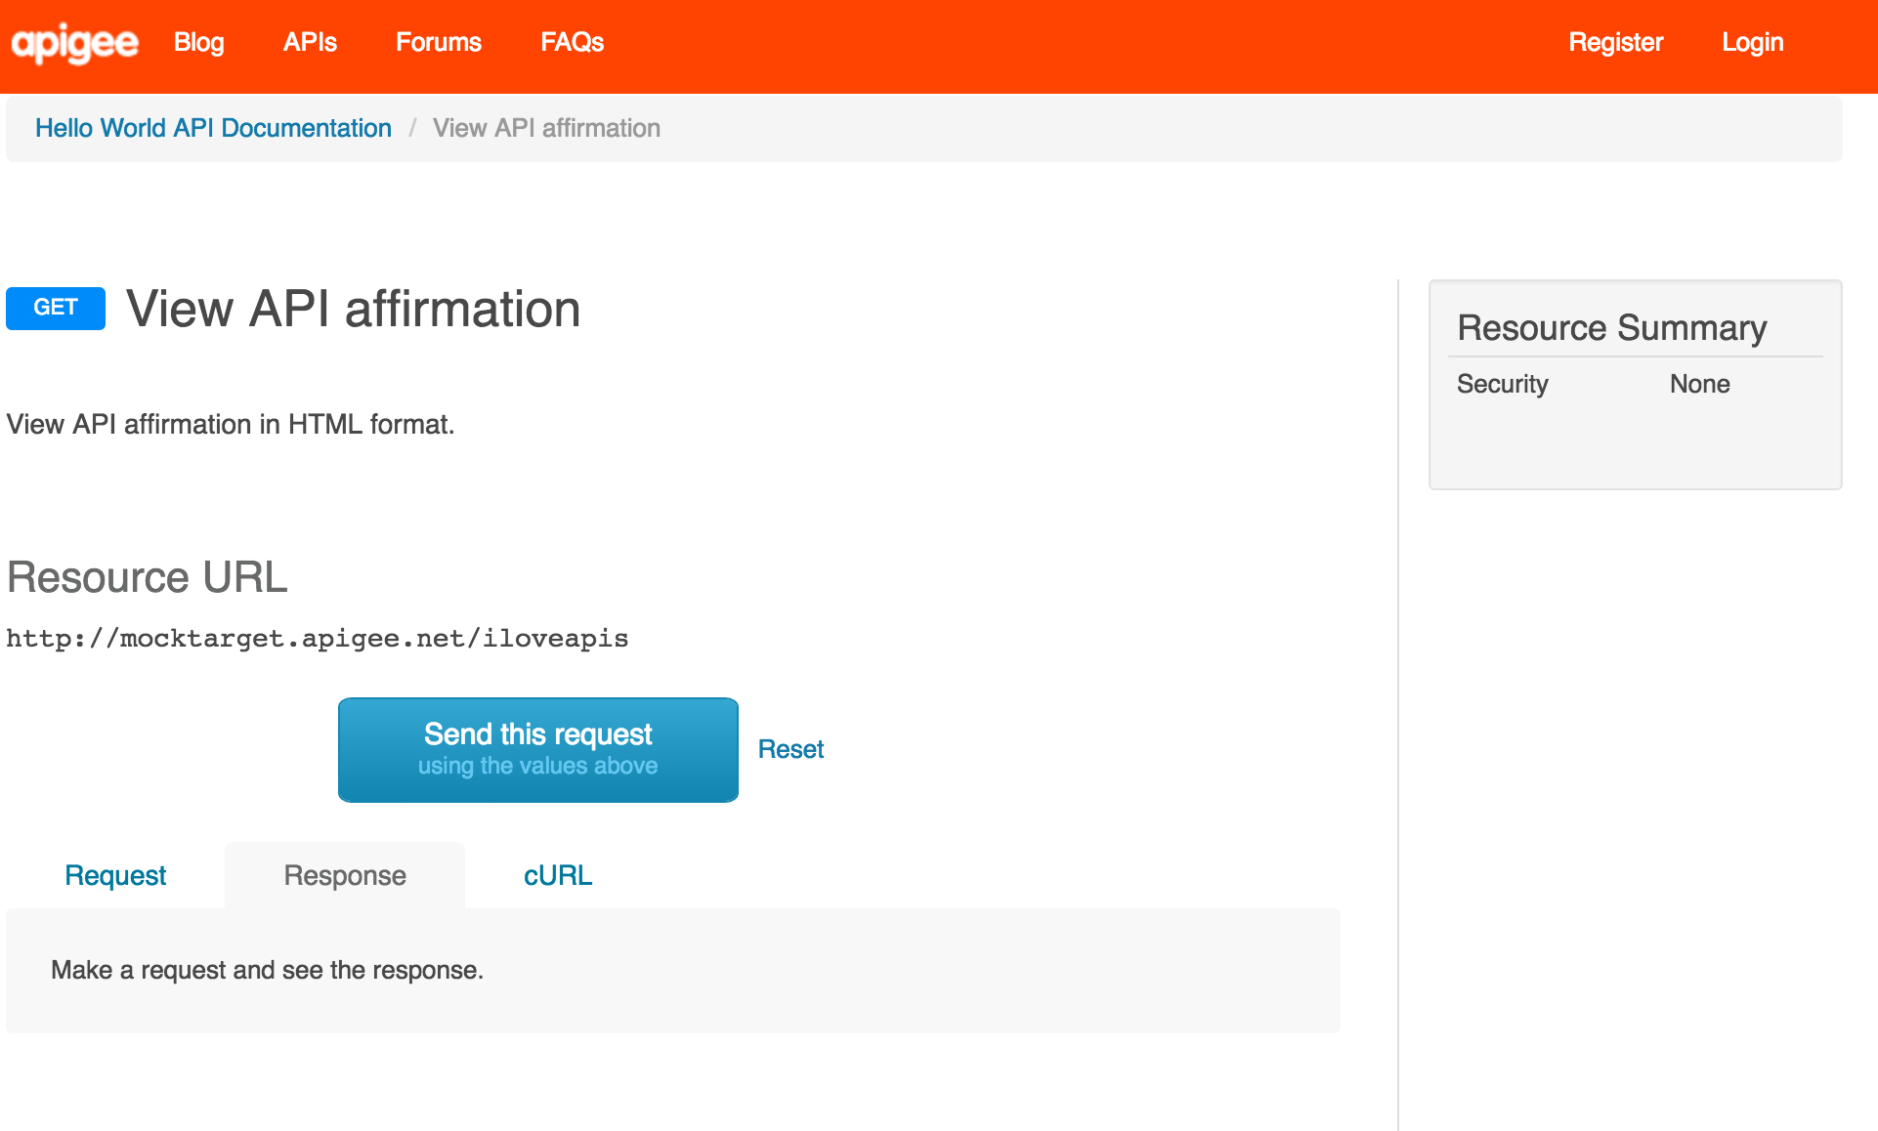
Rendered API Documentation
Smartdocs
Model Creation and OAS Import
Developer Portal
Interactive

Slide 9
SmartDocs
Manage SmartDocs using Management API
https://github.com/dzuluaga/apigee-tutorials/tree/master/apiproxies/sample-api-smartdocs
Publish to Developer Portal via API
https://community.apigee.com/articles/30739/apis-for-publishing-smartdocs-on-developer-portal.html

Slide 10
THANK YOU

